Slide 1

Northeastern University - Seattle
CS6650 Building Scalable Distributed Systems
Professor Ian Gorton

Slide 2
Building Scalable Distributed Systems
Week 4 – Scaling the Data Layer - Fundamentals

Slide 3
Outline
Scaling Databases
Partitioning and Replication
Consistency

Slide 4
Learning objectives
Explain the difficulties of scaling relational databases
01
Describe the advantages and disadvantages of partitioning and replication
02
Describe the strengths and weaknesses of distributed database architectures
03
Explain how consistency and conflicts are handled in leaderless systems
04

Slide 5
Scaling Databases

Slide 6
Relational Databases
Established database management system technology
Relational model based on defined schemas and SQL query language
Highly optimized, stable technologies
Scale up easily by running database on bigger machines
More memory, CPUs, disks
Many commercial/open source implementations
De facto enterprise technologies

Slide 7
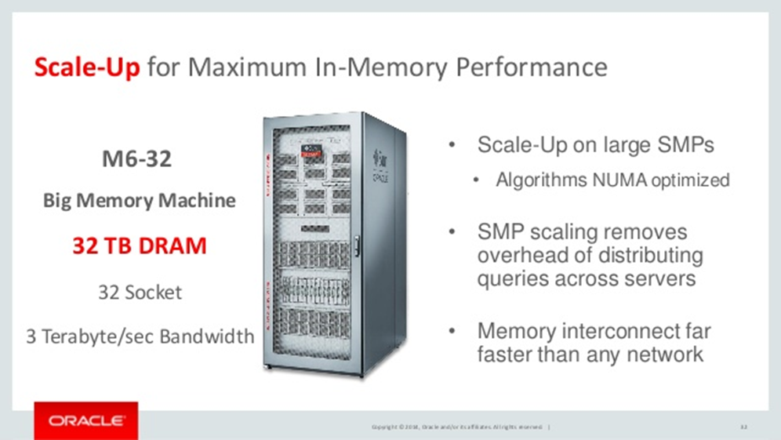
Scale Up – Example Hardware
Notes:
NUMA (non-uniform memory access) is a method of configuring a cluster of microprocessor in a multiprocessing system so that they can share memory locally, improving performance and the ability of the system to be expanded. NUMA is used in a symmetric multiprocessing ( SMP ) system.

Slide 8
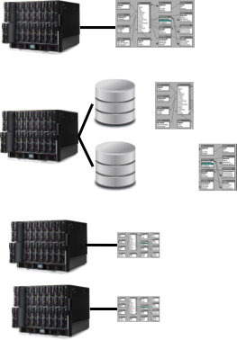
Scaling Relational Databases
Scale up
Monolithic compute resource
Shared disk
Partitioned databases on disk
Optimizes data placement on separate disks
Monolithic compute resource
Multiple database instances
Partition database across database engine instances
Functional partitioning common (e.g., customers, orders, stock)
More compute, more license costs

Slide 9
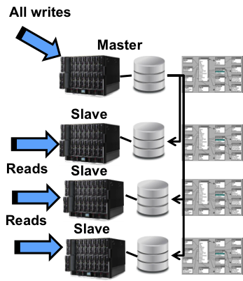
Scaling relational databases
Read/Write splitting
Writes to single master
Reads to multiple slaves
Reads scale
Writes are performance bound
Consistency weaker due to replication latency
Proprietary approaches, e.g.:
Scale better
Typically require application code changes or impose SQL restrictions

Slide 10
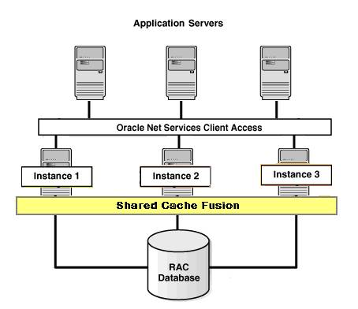
Scaling Relational Databases
Shared everything architecture
Oracle RAC
Multiple nodes run database engine
Requests load balanced
Single shared database using SAN storage
Shared cache

Slide 11
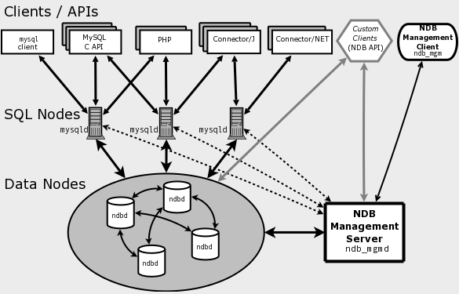
Scaling Relational Databases
MySQL cluster
Shared nothing architecture
distributed, multi-master with no single point of failure
Data node manages a partition of the database
Partitioned by hashing on the primary key for a table

Slide 12
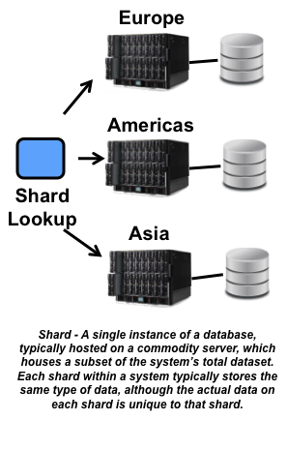
Scale out with clusters
Sharding
Horizontal data partitioning
Suitable for exploiting large clusters
Many possible partitioning schemes,
Value based – e.g., region, customer ID
Hashing
Issues:
Evenly distributing read load, write load, and data volume
Handling shard failures

Slide 13
Scaling Relational Databases is hard
Relational data modeling produces general solutions that can accommodate a broad range of queries
Driven by structure of the data
Can JOIN together data from different tables at query time
Scale up on expensive hardware is proven
But what about scale out on commodity hardware?
How do we partition data horizontally?
How we do efficiently perform and scale distributed joins?

Slide 14
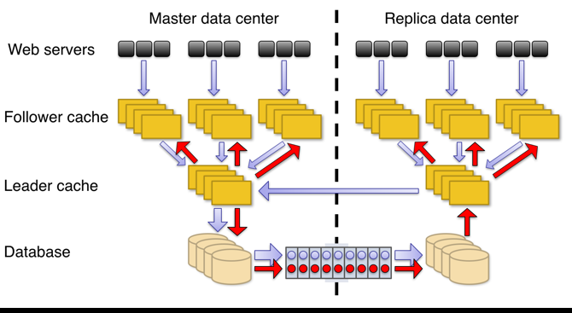
Facebook – Scaling MySQL
Originally built on MySQL/memcache
Scaling was hard
Extensive master-slave sharding across data centers
Loss of SQL language power (eg JOINs across shards)
Built TAO on top of MySQL
Custom graph database layer
Simple API maps to fast SQL queries
Optimized for reads (500:1 ratio)
Good blog post summary at https://blog.yugabyte.com/facebooks-user-db-is-it-sql-or-nosql/

Slide 15
Other Considerations
RDBMS originally conceived to store ‘business data’
Correct and timely
Consistent (ACID – we’ll be back on this one!)
Recoverable
As Internet drove growth for sites, new, non business critical, data types emerged
Log files
Tweets
Images
Social graphs
etc

Slide 16
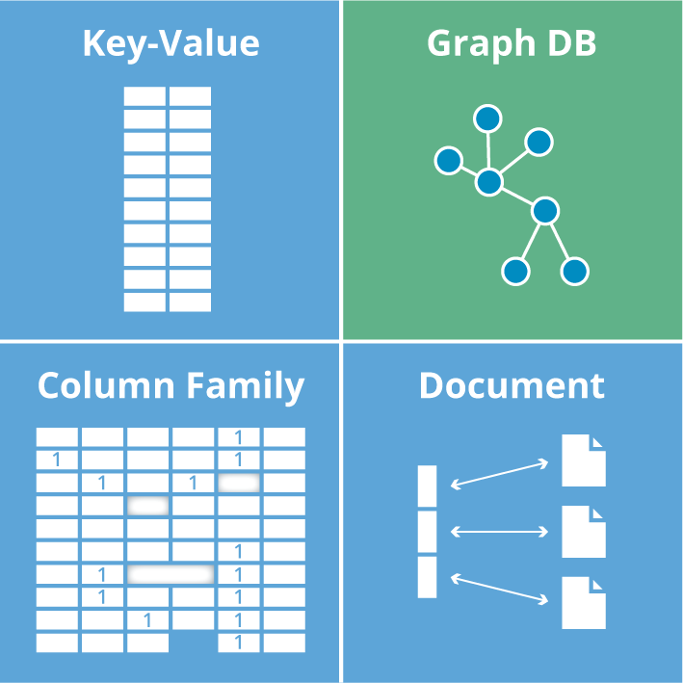
New databases emerge

Slide 17

NoSQL – Horizontally-scalable database technology
Designed to scale horizontally and provide high performance and scalability on commodity hardware
Large variety of:
Data models
Query languages
Scalability mechanisms
Consistency models
NoSQL data modeling driven by the needs of the specific applications that utilize the database
Driven by the application use cases and data access patterns
Denormalized for performance
Notes:
CouchBase - Elasticity (Zynga where a game takes off with no warning)
Cassandra – Facebook Inbox search (inverted indexes)
MongoDB – DoubleClick add serving.
Riak – key-value store for CRM application
Neo4J – Building CMS for Swedish military.

Slide 18
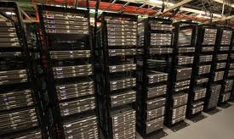

Distributed Databases
Move to distribution of data driven by:
Scale – BIG data!
Ecomonics – many commodity low cost machines are cheap for building clusters and data centers
Performance – more resources can be thrown at a problem
Availability – Internet-scale apps needs very high availability

Slide 19
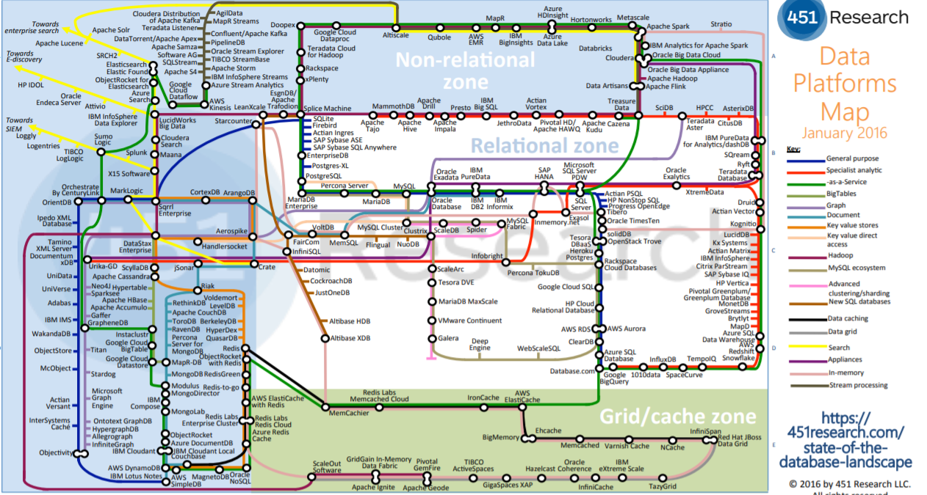
Database Landscape

Slide 20
Partitioning and Replication

Slide 21
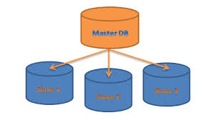
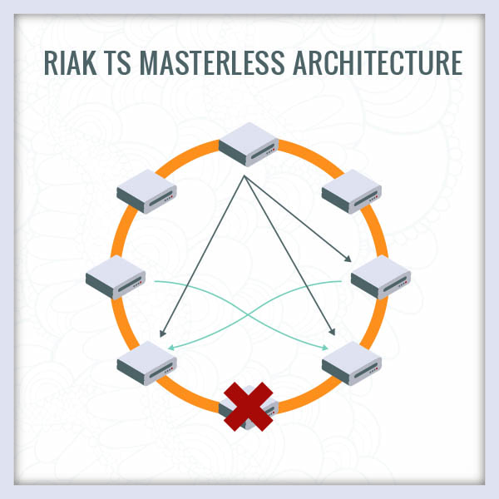
Two basic distributed database architectures
Leader-based (Master-Slave)
Leaderless (Peer-to-Peer)
Aka masterless
Shared nothing
Strengths and weaknesses for each …
Yep. Design trade-offs ….

Slide 22
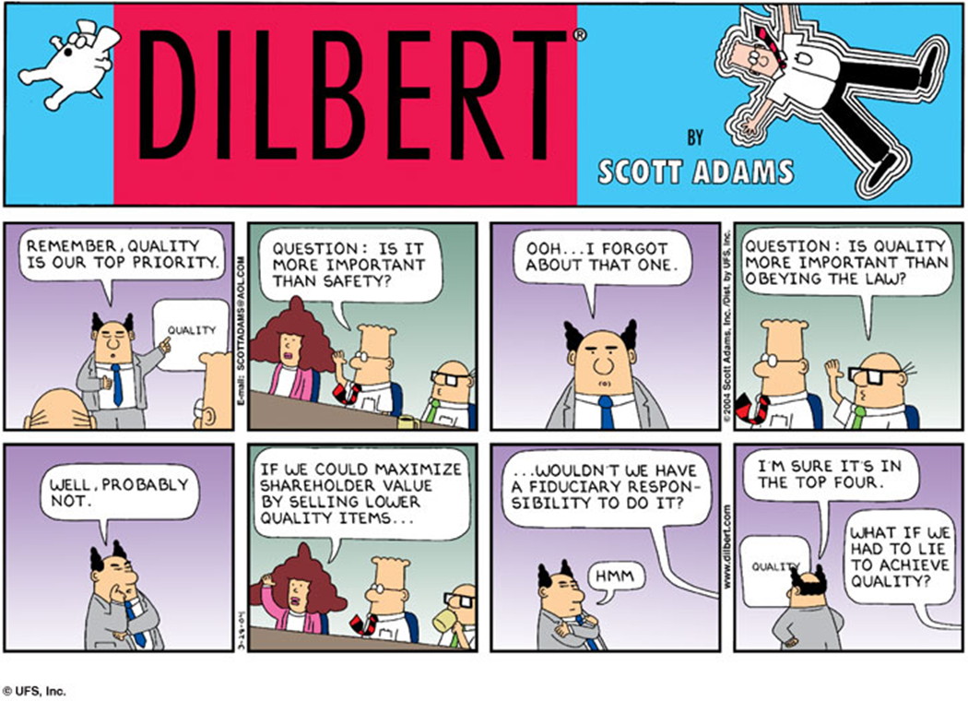

Slide 23
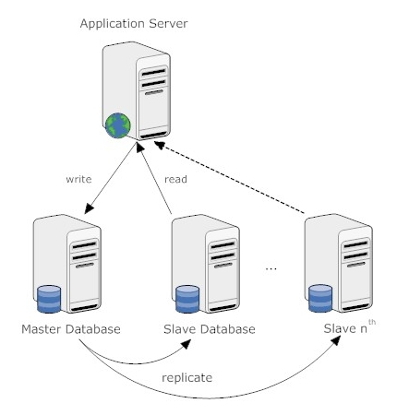
Leader-based Architecture
One leader, many followers
Write to leader
Read from followers
Strengths:
Single copy of data (ie the leader) is source of truth
Off loads reads to followers to enhance performance/scalability
Weaknesses
Window of inconsistency
Bottleneck at leader for writes
Availability?

Slide 24
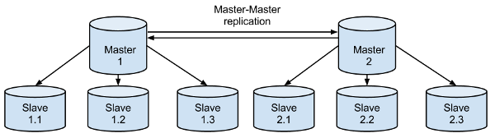
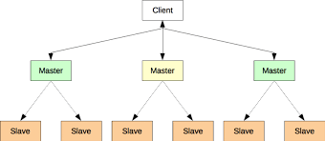
Multi-Leader-Follower Architecture
Replicated MLS
Partitioned MLS

Slide 25

Leader Failure Handling
What if the leader node fails?
Machine crashes
Network fails (possibly transient)
Sounds easy – let’s elect a new leader
Assume 4 followers
Elect one as leader
three remains followers

Slide 26
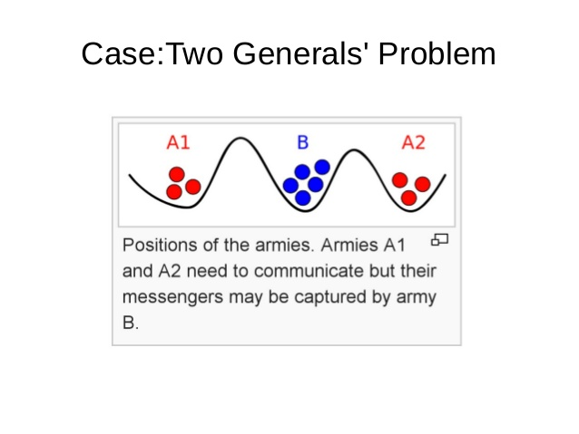
Achieving Consensus in Distributed Systems

Slide 27

https://www.youtube.com/watch?v=X7jzXlt6CgE

Slide 28
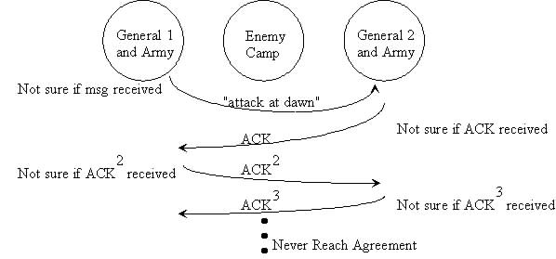
The Two Generals Problem

Slide 29
The Two Generals Problem
No 100% message delivery guarantee
It can be proven that this is impossible to solve
Ways to make the chance of failure to achieve consensus very small?

Slide 30
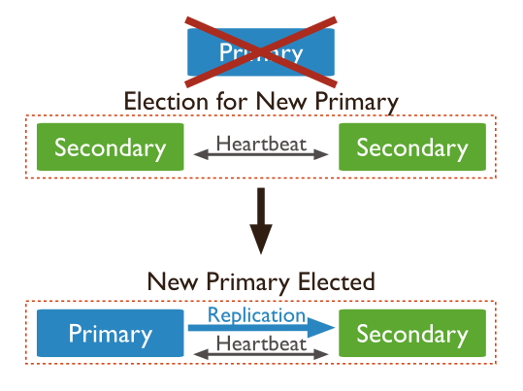
New Leader Election
Primary/Leader fails
How detected?
Potentially many followers (eg 7)
Election must satisfy safety and liveness properties :
only one single node can enter the elected state and it will become the leader of the distributed system.
every node will eventually enter an elected state or a non-elected state.
Many problems to address, eg:
What if followers are disconnected from each other?
Network partition, split brain problem
What if leader was simply unavailable and reconnects during the election process?

Slide 31

New Leader Election – The Bully Algorithm
Bully algorithm proposed by Garcia-Molina.
basic assumptions:
The system use timeouts to detect process failure (coordinator)
each process has a unique number in the system
every process knows the process number of all other processes and which processes have the higher number
Processes do not know which processes are currently up and which processes are currently down.
Once an election is held a process with the highest process number is elected as a coordinator which is agreed by other processes [4].
H. Garcia-Molina, “Elections in distributed computing system,”
IEEE Transaction Computer, vol.C-31, pp.48- 59, Jan.1982.

Slide 32
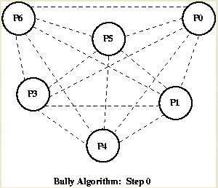
Bully Algorithm

Slide 33
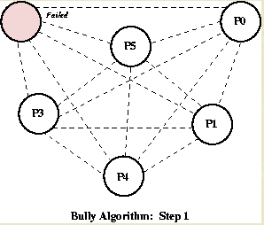
Bully Algorithm

Slide 34
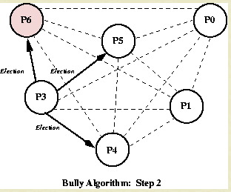
Bully Algorithm

Slide 35
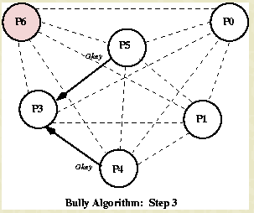
Bully Algorithm

Slide 36
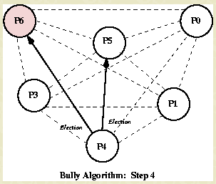
Bully Algorithm

Slide 37
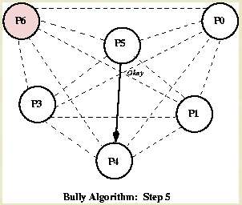
Bully Algorithm

Slide 38
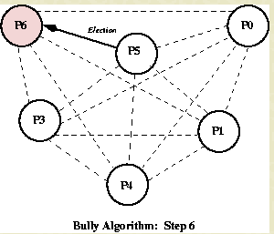
Bully Algorithm

Slide 39
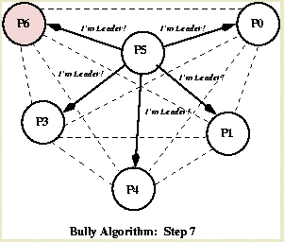
Bully Algorithm

Slide 40
Bully Algorithm - analysis
Complexity?
Time to make a decision?
What if highest number process is flaky?
Tolerant to network partition?
Nodes partitioned and each elects its own leader
Notes:
Network bandwidth utilization[edit]
Assuming that the bully algorithm messages are of a fixed (known, invariant) sizes, the most number of messages are exchanged in the group when the process with the lowest id initiates an election. This process sends (N-1) Election messages, the next higher id sends (N-2) messages, and so on, resulting in {\displaystyle \Theta \left(N^{2}\right)} election messages. There are also the {\displaystyle \Theta \left(N^{2}\right)} Alive messages, and {\displaystyle \Theta \left(N\right)} co-ordinator messages, thus making the overall number messages exchanged in the worst case be {\displaystyle \Theta \left(N^{2}\right)}.

Slide 41

Before we go on – A note on Byzantine Faults
A version of the N generals problem in which generals can lie,
Analogous:
System compromised by intruders
We assume systems don’t lie in this course
Some types of systems must be Byzantine Fault Tolerant though:
Flight control systems: radiation can corrupt bits in memory
Multi-organizational systems (eg Bitcoin)

Slide 42


Lab Exercise
Let’s Experiment with data models in MySQL

Slide 43
Consistency

Slide 44
Consensus Defined
a majority of Core Servers in a cluster (N/2+1)
Leader election is an example of requiring consensus in distributed systems
Consensus:
multiple servers agree on a shared state even in the face of failures.
Eg agree who is the leader node
An important topic when we have no leader, ie:
Peer-to-peer
Shared-nothing

Slide 45
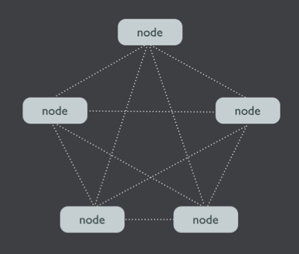
Peer-based Replication
“leaderless”
No leader copy
All copies equal
Read to and write from any copy
Updates propagate to replicas
Synchronously
Asynchronously
Advantages?
Disadvantages?

Slide 46
Algorithms (more on this later)
Leader election approaches:
https://en.wikipedia.org/wiki/Leader_election#Universal_leader_election_techniques
General consensus
Paxos (complicated!!)
https://www.microsoft.com/en-us/research/publication/paxos-made-simple/
Raft
https://raft.github.io/
In Search of an Understandable Consensus Algorithm
http://thesecretlivesofdata.com/raft/
Another approach:
https://www.mongodb.com/presentations/replication-election-and-consensus-algorithm-refinements-for-mongodb-3-2

Slide 47
Peer-based Replication
Advantage – can write to any node
Improved write throughput
How do we keep all copies the same if multiple clients write to same object on different replicas?
This brings us to replica consistency …

Slide 48
Consistency
Two extremes:
Strong consistency:
All replicas must exhibit same value to clients at all times
Important in e.g finance/banking
Eventual Consistency
Some replicas may be stale (hopefully not for long)
Clients may see inconsistent values when reading the same value
Fine in e.g. Twitter feeds

Slide 49
Eventual Consistency
Promotes availability over consistency
Optimistic
Consistency achieved with some latency (eventually)
Availability achieved through partitioning and replication
Requires successful write to one or more replicas
Consistency achieved through background mechanisms
Latency for achieving consistency affected by number of replicas
Notes:
Basically Available: This constraint states that the system does guarantee the availability of the data as regards CAP Theorem; there will be a response to any request. But, that response could still be ‘failure’ to obtain the requested data or the data may be in an inconsistent or changing state, much like waiting for a check to clear in your bank account.
Soft state: The state of the system could change over time, so even during times without input there may be changes going on due to ‘eventual consistency,’ thus the state of the system is always ‘soft.’
Eventual consistency: The system will eventually become consistent once it stops receiving input. The data will propagate to everywhere it should sooner or later, but the system will continue to receive input and is not checking the consistency of every transaction before it moves onto the next one. Werner Vogel’s article “Eventually Consistent – Revisited” covers this topic is much greater detail.
If we consider this from the user's perspective, however, this lag may not be relevant or even known. Neither the receiving user nor the sending user may know when the asset arrived. If the lag between sending and receiving is a few seconds, it will be invisible or certainly tolerable to users who are directly communicating about the asset transfer. In this situation the system behavior is considered consistent and acceptable to the users, even though we are relying upon soft state and eventual consistency in the implementation.

Slide 50

Eventual Consistency
Client 1
Replica 1
Replica 2
Replica 3
1
1
1
Value = 5
5
Value = 5
Client 2
Value =5
5
5
Read
Value =5

Slide 51


Eventual Consistency
Client writes are sent to (typically) one coordinating replica
Coordinating replica:
Performs update and informs client
Sends update to other replicas
Receives acknowledgement of success (hopefully!)
If a replica is dead, things get tricky
Eg hinted handoff (more later)
If N replicas:
Client may choose to write to >1 replicas
Decrease inconsistency window
Longer write latencies
Notes:
Hinted handoff Whenever a node becomes unresponsive or down for a certain period of time, all the write requests to that node will fail. Cassandra keeps a copy of the partitions that were supposed to be written to the unresponsive node within a local hints table. The hints are stored for a certain configurable period of time. When the downed node comes up and starts gossiping with the rest of the nodes in the cluster, the hints are replayed to the downed node, and data is back in sync between all the replica nodes.The coordinator node will eventually evict hints if the downed node doesn't come back up within the eviction period. The coordinator also stops storing hints related to a downed node if it is down for a configurable period of time.

Slide 52

Eventual Consistency
Client 1
Replica 1
Replica 2
Replica 3
1
1
1
Value = 5
5
Value = 5
Client 2
Value =5
5
Read
Value =1
5
Stale read

Slide 53
Read your own writes
if a process performs a write w, then that same process performs a subsequent read r, then r must observe w’s effects.
Example:
User changes default credit card on a site
i.e. write new credit card details
User executes a transaction with default credit card
i.e. read credit card details
Expect to use new card (not old one!)

Slide 54
Eventual Consistency
Client 1
Replica 1
Replica 2
Replica 3
1
1
1
Value = 5
5
Stale read
Value = 5
Value =5
5
Read
Value =1
5

Slide 55
Quorum Reads and Writes
Quorum = majority
In a leaderless system, let’s define:
N is number of replicas
W = number of replicas that need to be updated on every write
R = number of replicas that need to be read to get latest value
Assume data is versioned somehow (version number, timestamp) so latest value can be discerned

Slide 56
Eventual Consistency
Client 1
Replica 1
Replica 2
Replica 3
1
1
1
W=2
Value = 5
Client 2
R=2
5
Value = 5
Read request
5
Value =5
Read
Value =5
(the most up to date value)
Value =5
5

Slide 57

Quorums
If both W and R obey (N/2)+1, this is known as quorum
Essentially a majority of replicas must accept a write or agree on a read
If N=5, quorum is W=3 and R=3
Or W+R>N
Read your own writes?
Overlap in set of nodes written to and read from
If everything works fine, yep!

Slide 58


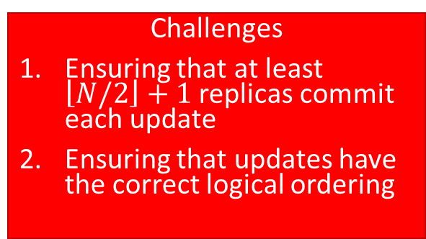
High-Level Quorum Example
ts: 1
Bob: $300
ts: 1
Bob: $300
ts: 1
Bob: $300
ts: 1
Bob: $300
ts: 1
Bob: $300
ts: 2
Bob: $400
ts: 3
Bob: $375
ts: 2
Bob: $400
ts: 2
Bob: $400
ts: 3
Bob: $375
ts: 3
Bob: $375
Write
Read
Challenges
Ensuring that at least $\left\lfloor N/2\right\rfloor +1$ replicas commit each update
Ensuring that updates have the correct logical ordering
timestamp | Balance
1 | $300
2 | $400
3 | $375

Slide 59
Advantages of Quorums
Availability: quorum systems are more resilient in the face of failures
Efficiency: can significantly reduce communication complexity
Do not require all servers in order to perform an operation
Requires a subset of them for each operation

Slide 60
Quorum ‘Quirks’
A write in progress when read issued on same key
New value not persisted on all replicas
What is returned?
Write succeeds on some replicas but fails on others (e.g. partition, power fails) such that W replicas not updated
Writes are not rolled back on successful replicas
Error returned to client – retry?
If no retry, reads may return stale data and object will be inconsistent until next write
‘Sloppy’ quorums … next topic!!
Notes:
Case 1 – who knows!!
Case 2 – RYOW can be violated
Case 3 – sloppy quorums violate RYOW as strict quorum not acheived

Slide 61
Quorum Consistency
We can adjust values to achieve required consistency levels:
If N=5, R=5, W=1, what is effect?
If N=5, R=1, W=5, what is effect?
If N=5, R=1, W=5, and one replica is down, what is effect?
If N=5, R=2, W=1, what is effect?
Notes:
If N=5, R=5, W=1, what is effect? – consistent slow reads, fast writes
If N=5, R=1, W=5, what is effect? – consistent reads, slow writes
If N=5, R=1, W=5, and one replica is down, what is effect? – write unavailable
If N=5, R=2, W=1, what is effect? – stale reads

Slide 62

Hinted Handoffs
Any old Node
5
Client 1
Replica 1
Value = 5
Assume network partition:
Client writes/reads cannot achieve quorum
If availability is key requirement
Accept write even with W=2
Write to a reachable node and update replicas when they become available
Known as a Sloppy Quorum
As opposed to a strict quorum
Assured durability on N nodes
Temporary home for value
Hinted handoff occurs when replicas become available and recent values sent from temporary home
W=2
5
Replica 2
1
Replica 3
1
Notes:
Optional feature in most leaderless DBs

Slide 63

Handling Conflicts
Writes to the same key can be sent to different replicas ‘at the same time’
Two writes to same key can overlap as replicas are updated
Variable network latencies
Node failures
Network partition
Slow nodes
Essentially writes do not know about each other as they occur on different set of nodes

Slide 64
Conflicts
Client 2
Client 1
Replica 1
Replica 2
Replica 3
1
1
1
Value = 5
Value = 7
5
7
Value = 5
5
Value = 7
Value =5
7
Value = 7
5
7
Notes:
Permanently inconsistent values

Slide 65
Simple Solution – Last Writer Wins
Use timestamps to determine most up to date value
If we see conflicting writes, simply persist the most recent value at all replicas
Ensures replicas remain consistent
Issue: which clock generates timestamp?
Client’s?
Coordinator’s?
Replicas?

Slide 66

Last Writer Wins
Key1:PLaylist
Client 2
Client 1
“”
read
write
“Angie”
“Angie”,
“Brown Sugar”
“Angie”,
“Paint it Black”

Slide 67

Lose Some Writes!!
Effectively a race condition
Writes can be overwritten
Ie not durable
But reported as successful to the client!
Written to W replicas
LWW leads to data loss
Safe only when a key is written once and afterwards is regarded as immutable
Changes written to new rows and merged programmatically
Notes:
Without vector clocks, Cassandra can’t safely change a cell–but writing immutable data is safe. Consequently, Cassandra has evolved around those constraints, allowing you to efficiently journal thousands of cells to a single row, and to retrieve them in sorted order. Instead of modifying a cell, you write each distinct change to its own UUID-keyed cell. Then, at read time, you read all the cells back and apply a merge function to obtain a result.

Slide 68

Conflicts – a Better Solution - Causality
Track causality
Example:
Two users login to systems at 8.00am on local machines
Clock drift means we don’t know which logged on first?
If user1 logs in and sends message to user2, and message is received before user2 logs in, we know:
User1 login ‘happened before’ User2 login
If message received after users2 logs in
We still don’t know the order
Events are not causally related
i.e concurrent

Slide 69

Lamport Clocks
Algorithm to provide a partial ordering of events in a distributed system
Every process maintains a local logical clock
Effectively a counter, initialized to zero
When a process sends a message or executes an internal step, it sets clock ← clock + 1
assigns the resulting value as the clock value of the event.
If it sends a message:
it piggybacks the resulting clock value on the message.
When a process receives a message,
it sets its clock ← max(clock, message timestamp)+1
the resulting clock value is taken as the time of receipt of the message.

Slide 70
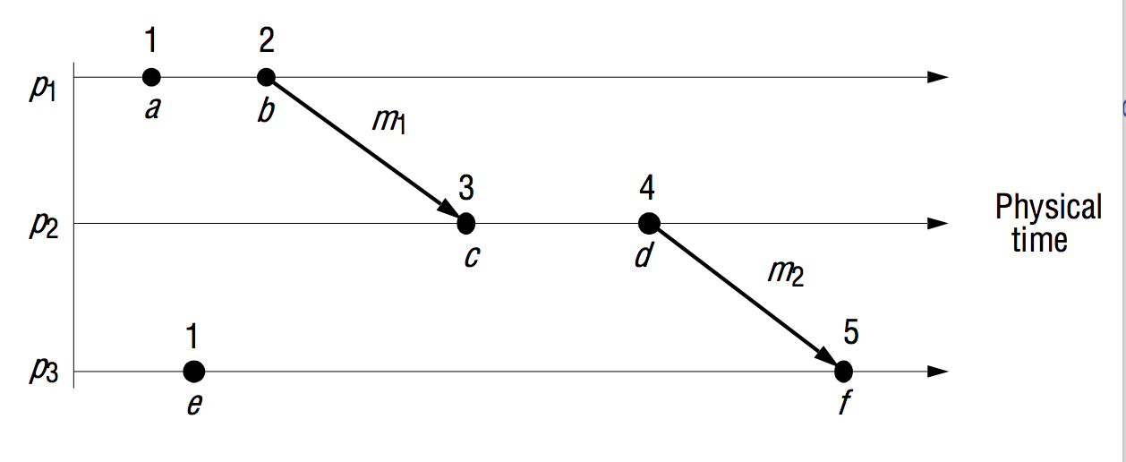
Lamport Clocks

Slide 71

Lamport Clocks
Identify a happened-before ordering that is described numerically
if C(a)<C(b), C(a) happened-before C(b).
Partial causal ordering
Only meaningful in terms of messages flowing between a group of processes
If a and b are two events in the same process, and a comes before b, then a -> b.
If a denotes the sending of a message and b the receipt of that message, then a -> b.
If a -> b and b -> c, then a -> c.

Slide 72
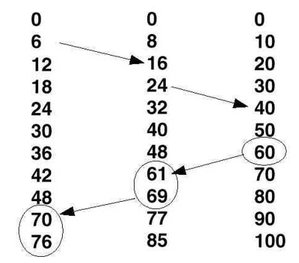
Lamport Clocks – Partial Ordering

Slide 73


Lamport Clocks - Example
User 1
Shared File
Copy on each machine
User 1
Open file
1
2
3
Open file
4
3
5
4
Close file
6
8
7
Save file
9

Slide 74

Conflicts
How do we detect the siblings for a key?
Versioning
Vector Clocks
Version Vectors
Who does the merge?
The client – database presents siblings and client decides what to do
Maybe with help of a person!!
Conflict-free Replicated Data Type (CRDTs)
Sets, lists, maps, counters, ordered lists, etc
Ongoing research …

Slide 75
How do we handle conflicts?
Key1:PLaylist
Client 2
Client 1
“”
“Angie”
“Angie”,
“Brown Sugar”
“Angie”,
“Brown Sugar”
“Angie”,
“Paint it Black”
SIBLINGS - MERGE
“Angie”,
“Brown Sugar”
“Paint it Black”

Slide 76


Basic Algorithm
Key1:PLaylist
Client 1
Client 2
vv1
“”
read
vv1
“Angie”
vv2
vv2
vv2
“Angie”,
“Brown Sugar”
vv2
“Angie”,
“Brown Sugar”
“Angie”,
“Paint it Black”
vv3
SIBLINGS –
MERGE
vv3
“Angie”,
“Brown Sugar”
“Paint it Black”

Slide 77
Conflict Resolution
Server creates a version for each key/replica
Clients must read key and get associated version before writing
Client write sends new value along with version that was read
If server version of key same as version number in write, server updates value and creates new version
If server version not same as version number in write, server creates siblings due to a concurrent write (also if no version sent with write)
When client read is returned siblings, it must merge values and write to create a new version number

Slide 78



Slide 79
Strong Consistency (next week!)

Slide 80
Summary
Relational databases scale best vertically and suited to business data
Different applications can tolerate weaker guarantees and need massive scalability
NoSQL databases based on leader-follower and leaderless architectures
Eventual consistency is achievable in leaderless systems using quorums (as long as everything behaves!)
Conflict resolution possible in leaderless systems using versioning

